Slide 1
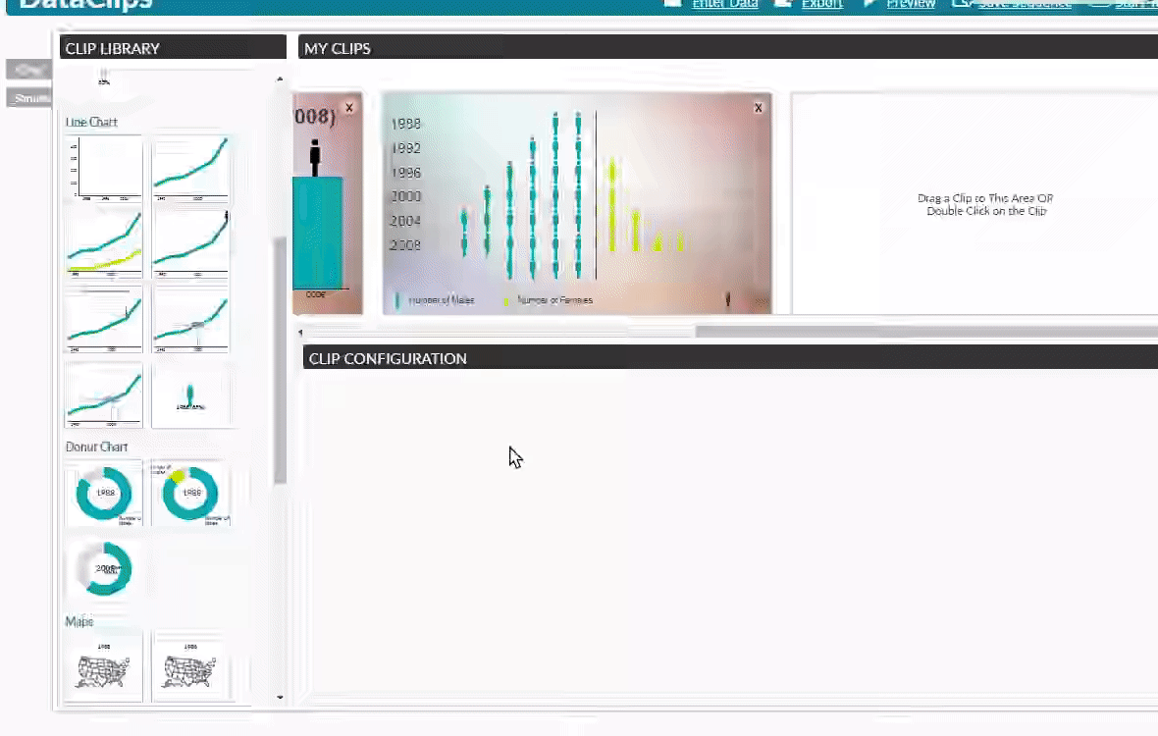
Visual Narratives: Data Video
DataClips: http://dataclips.azurewebsites.net/
F. Amini, et al. "Authoring Data-Driven Videos with DataClips," in IEEE Transactions on Visualization and Computer Graphics, vol. 23, no. 1, pp. 501-510, Jan. 2017.

Slide 2
…So, what’s any of that got to do with BEA?
“The Visualization Pipeline”
Data
Visual Form
Raw Data
Data Tables
Visual Structures
Views
Transform
Map
Transform
Human Interaction
S.K. Card, J.D. Mackinlay, and B. Shneiderman [eds.], “Readings in information visualization: using vision to think.” Morgan Kaufmann, 1999.

Slide 3
…So, what’s any of that got to do with BEA?
“The Visualization Pipeline”
Data
Visual Form
Raw Data
Data Tables
Visual Structures
Views
Transform
Map
Transform
Human Interaction
S.K. Card, J.D. Mackinlay, and B. Shneiderman [eds.], “Readings in information visualization: using vision to think.” Morgan Kaufmann, 1999.

Slide 4
…So, what’s any of that got to do with BEA?
BEA
“The Visualization Pipeline”
You (Data Users)
Data
Visual Form
Raw Data
Data Tables
Visual Structures
Views
Transform
Map
Transform
Human Interaction
S.K. Card, J.D. Mackinlay, and B. Shneiderman [eds.], “Readings in information visualization: using vision to think.” Morgan Kaufmann, 1999.

Slide 5
Data and Tools
Getting and reshaping the data: Extract, Transform, Load (ETL)
Manually via UI
Programming language (commonly R, Python, JavaScript)
Our use case: BEA API using R with package bea.R
Visualization
Industry standard: D3.js (JavaScript) [warning: steep learning curve]
Leaflet (JavaScript library; ported to R) is common for geospatial data
plot.ly (JavaScript library; ported to R, Python, MATLAB)
ggplot2 in R for static visualization, ggvis for interactive visualization
UI: Excel, Tableau, vega.github.io, keshif.me

Slide 6
Demo https://us-bea.github.io/econ-visual-guide

Slide 7
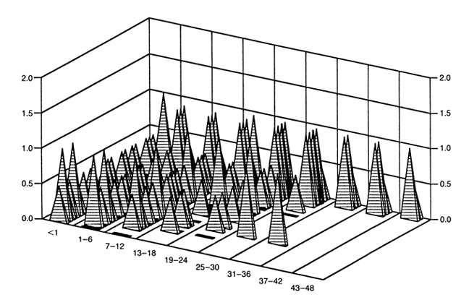
A Final Word of Warning
“For […] small data sets, usually a simple table shows the data more effectively than a graph, let alone a chartjunk graph.”
–Edward Tufte, The Visual Display of Quantitative Information. 2001

Slide 8
…And advice
SKETCH FIRST(ish)!

Slide 9
Thank you! Jeffrey.Chen@bea.gov Andrea.Julca@bea.gov https://github.com/us-bea/

